Slide 1
Workplace Health & Safety
Assessment 1 - Game Art
Student Name
DUE DATE:

Slide 2
Introduction
Introduction:
This assessment will examine the process of writing a WHS management plan for a fictional game studio, in line with the provided scenario. The provided brief is designed to collect all the evidence of competency you require for this subject. Following an alternative brief and/or presenting additional evidence of competency needs to be negotiated with your teacher.
The assessment will include:
Analysing a scenario.
Identifying WHS responsibilities.
Conducting hazard and risk assessments.
Implementing WHS control measures.
Evaluating control measures.
Planning WHS Training.
Observing and maintaining healthy work practices.
The assessment instructions:
All sections marked in green must be edited/filled out by each student. Be sure to replace “Student Name” on the first slide and include your name in the document filename.

Slide 3

Scenario|VR Game Demo
Overview:
You are the manager of a small studio “IntenseVR Games” who have been invited to demonstrate your new multiplayer Virtual Reality game demo at the GamesRock convention.
Your game is a full VR competitive multiplayer, fast paced action, sci-fi, horror game which allows the player to use melee attacks as well as jump, duck and dodge.
It is 48 hours until showtime and there are still a lot of bugs to sort out back at the studio and your team will need as much time as they can get to fix them all.
The booth needs to be delivered and set up 12 hours before the doors open, this will
Involve the studio manager taking a team of 3-4 to construct the heavy framework
for the booth and setup all the equipment, which includes:
4 PC’s.
4 60inch OLED Display screens.
Overhead lights.
Sound system.
4 VR play areas.
The game will be periodically demonstrated by outsourced promotion company models in high action competitive matches as well as non-competitive sessions for the general public to play.
The all ages event runs until 10pm, pack down is to be completed by midnight.
There will be food and drink at the venue and areas must be kept clean at all times.

Slide 4
Health & Safety|Hazard list
As part of a class discussion, list any potential hazards which could arise in the provided scenario.
Mechanical:
Physical:
Chemical:
Psychological:
Electrical:

Slide 5
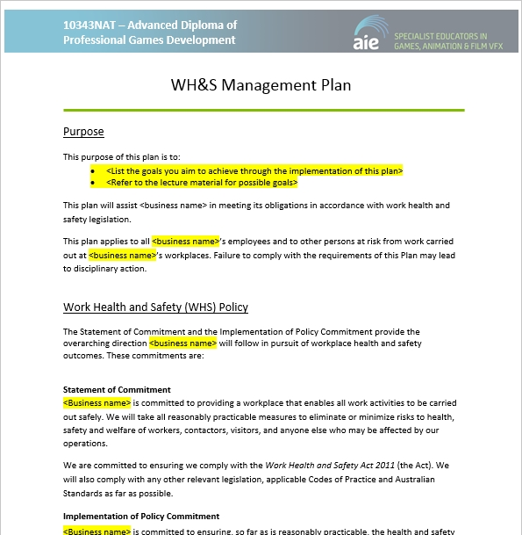
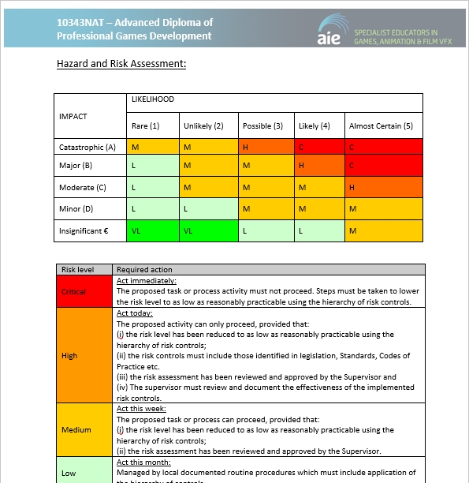
Health & Safety|WHS Management Plan
Utilising the above scenario complete all sections of the provided WHS management plan.

Slide 6
Workplace Health & Safety|Submission
The following files must be uploaded to Canvas for assessment. All submitted files must adhere to the provided naming conventions.
WHS Management Plan:
The WHS Management plan
YourName_HealthAndSafety_WHSManagementPlan.doc
Workbook:
The assessment workbook.
2021_HealthAndSafety_ YourName.pptx

